Slide 1
Shared Stack Implementation and Analysis Using Queue Delegation and Elimination
Mike Thomson (mt29253), Esha Choukse (ec27876)
Multicore Computing, Fall 2014
November 25, 2014

Slide 2
Agenda
Background
Queue Delegation
Elimination
Implementation
Results and Analysis
Conclusion

Slide 3
Background
atomic
Delegate
Thread
Critical
Section
Worker
Threads
Delegation Queue
Queue Delegation

Slide 4
Background
Queue Delegation
Multiple threads accessing a shared data structure
Locks – lead to slower, sequential behavior
Delegate task to a thread already operating on the data structure
No lock needs to be acquired
Thread can continue with other work
Delegate thread could be
Designated thread – same delegate thread throughout
Any thread – acquire a lock to become the delegate thread
Delegate thread executes the tasks from the delegation queue
Insertion doesn’t require locks – uses atomic types or CAS
Queue stops accepting tasks after a limit is reached

Slide 5
Background
Multiple threads accessing a single structure increases contention, reduces performance
Elimination
Operations with reverse semantics can be cancelled out
For example, PUSH and POP operations on a stack
Does not need to access the actual shared data structure
Reduces contention – better performance
Implemented using an array of exchanger slots
No locks needed – uses CAS

Slide 6
Implementation
MonitorT ^{[2]}
Used to compare performance against our implementation
JAVA-based
Uses queue delegation without elimination
Uses a designated delegate “manager” thread throughout the execution
We did not add elimination to the MonitorT libraries
Modified a different set of libraries, discussed in the next slide

Slide 7
Implementation
Queue Delegation
Uses “Queue Delegation Locking” C++ libraries published by Klaftenegger^{[1]}
Allows any worker thread to become the delegate thread by acquiring a lock
Delegate thread
Acquires the lock
Opens the delegation queue to start accepting tasks till the maximum limit is reached
Executes all the tasks in the queue
Returns the results to the threads using promise and future variables
Releases the lock once the queue is empty
Important attribute affecting performance:
Maximum allowed queue length
Using a worker thread as a delegate thread (not a dedicated delegate thread)

Slide 8
Implementation
Acquire delegate lock
Elimination
Added elimination to the existing queue delegation for implementing a shared stack
Elimination worker thread
Tries to acquire the delegation lock
If fails, tries to enqueue its task for delegation
If it fails to enqueue (queue was closed or full)
Tries to enter the elimination array
If it gets a match, exchanges the values and leaves
Else, waits for a match to happen, till it times out
If no match was found, starts over
Becomes delegate thread
Tries to enqueue task
Gets promise/ future value
Access elimination array
Match found
No match / Timeout

Slide 9
Implementation
Elimination
Exchanger has four states:
EMPTY, PUSH_WAIT, POP_WAIT, BUSY
Helps prevent false matches
Important attributes affecting the performance:
Array length
Range policy

Slide 10
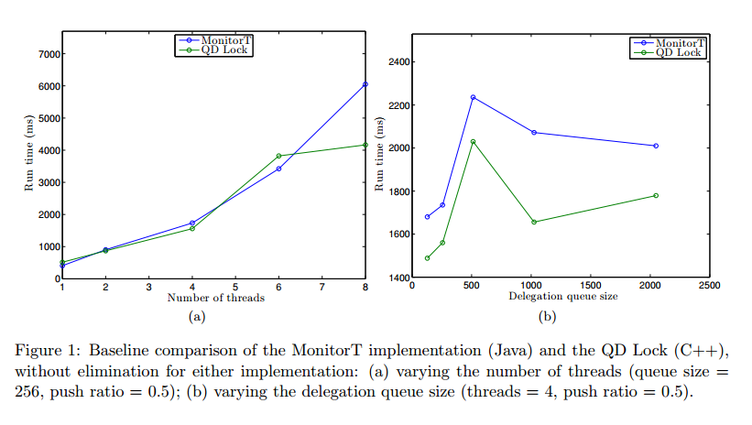
Results

Slide 11
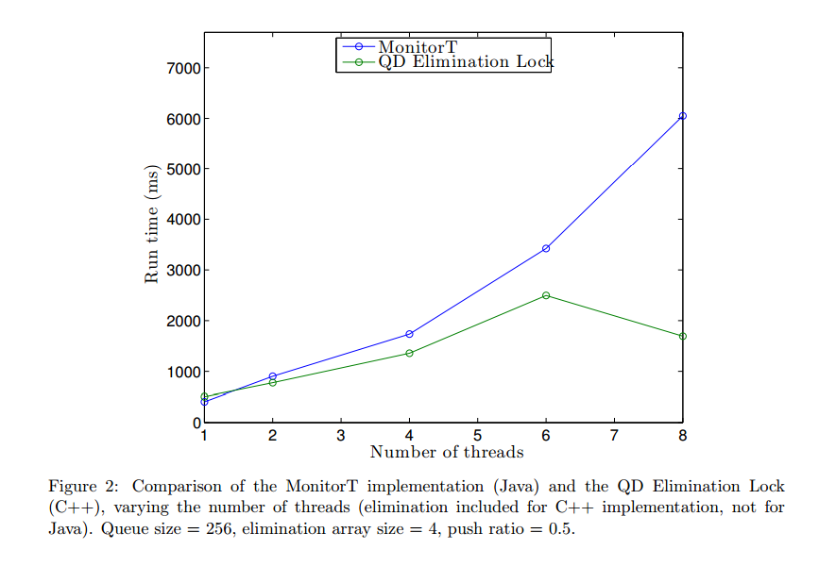
Results

Slide 12
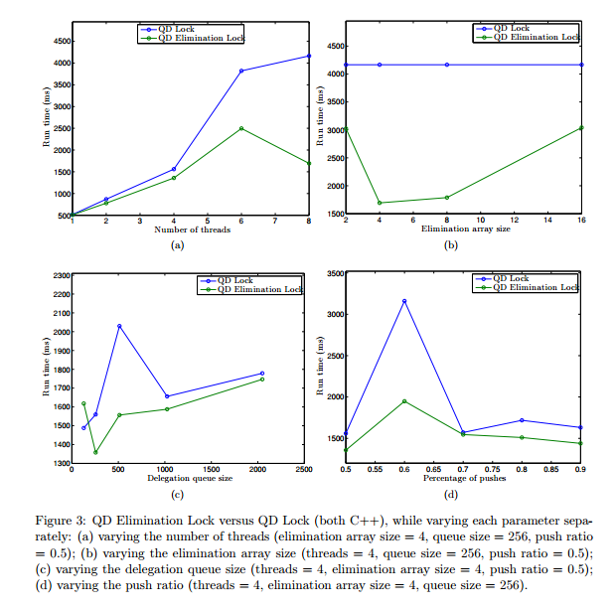
Results

Slide 13
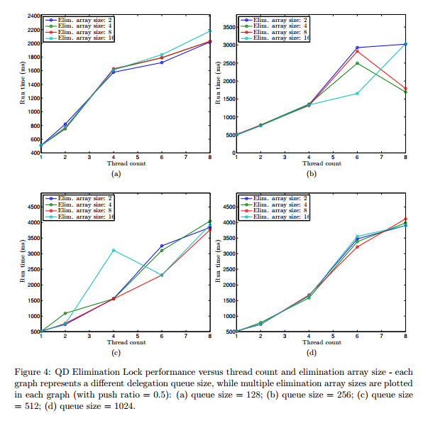
Results

Slide 14
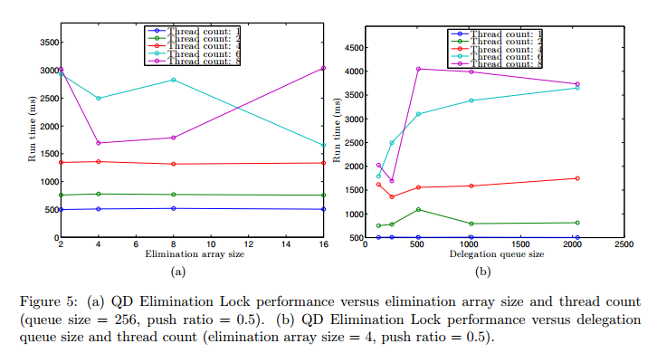
Results

Slide 15
Conclusion
Baseline performance of MonitorT is similar to QD Lock
They have different implementations of delegation
JAVA vs C++ performance comes into play too
QD elimination lock improves upon both QD Lock and MonitorT
Apart from a few anomalies, QD elimination lock
Provides greater benefits with larger number of threads
Gives better performance for a mid range of Elimination Array size
Too small a size leads to contention – always busy
Too big a size leads to lesser matches – always waiting
Gives better performance with smaller delegation queue size
Longer queue size means that the delegate thread cannot carry on with its own execution for a long time
Unexpectedly, percentage distribution of pushes and pops did not seem to affect the performance adversely

Slide 16
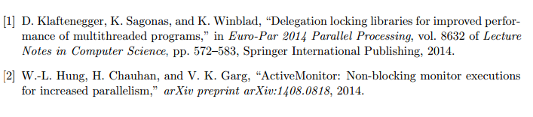
Bibliography

